Slide 1
04. Low-fi Prototype & Evaluation
Team Mango
May 3, 2023
CS 337E: Design for Global Grand Challenges

Slide 2




Team Mango
Homeschool Education
Nathan M.
Christina K.
Claire M.
Grace Z.
CS, AI Coterm
Econ, HCI Coterm
CS, HCI Coterm
CS, HCI Coterm

Slide 3
Problem Space
&
Solution

Slide 4
Problem Space + Solution Overview
All students deserve access to a quality education.
Not all homeschooling parents have the resources or experience to provide such an education, leading to unequal outcomes during schooling and later in life.
We want to level the playing field and provide resources for homeschooling parents to be better equipped and more empowered in their teaching, for their kids.

Slide 5
Mission Statement
Value Proposition

Slide 6

Mission Statement
Our mission is to empower homeschooling parents with tools for effective teaching and feedback delivery. We are dedicated to equipping parents as they seek to create engaging and inspiring learning environments at home.

Slide 7

Value Proposition
Personalized Feedback Solutions:
Live lesson tracking and generated reports to help parents tailor feedback strategies to their child's individual needs
Actionable insights and recommendations
Empowerment and Confidence:
Through insights on live lessons and simulations, gain experience and confidence in teaching

Slide 8
Concept Sketches

Slide 9
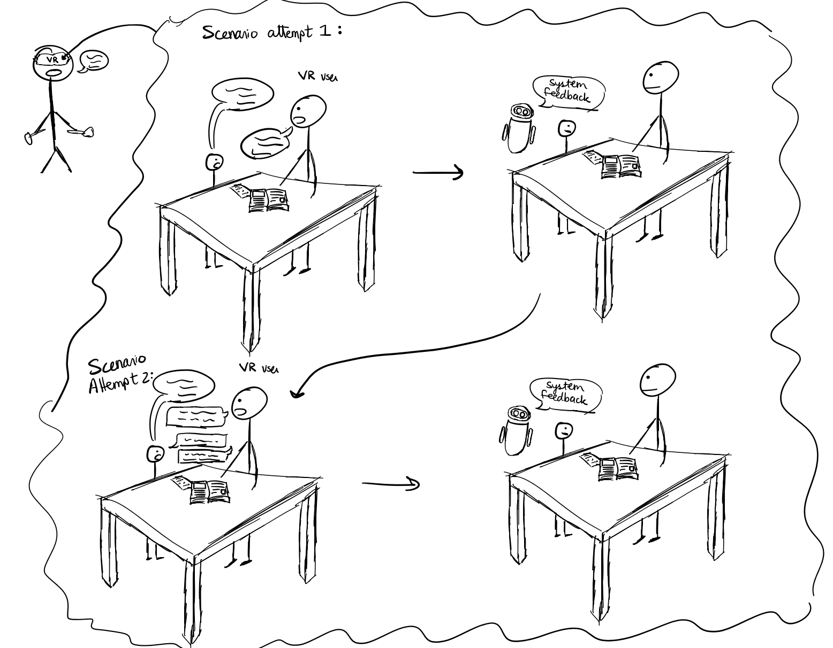
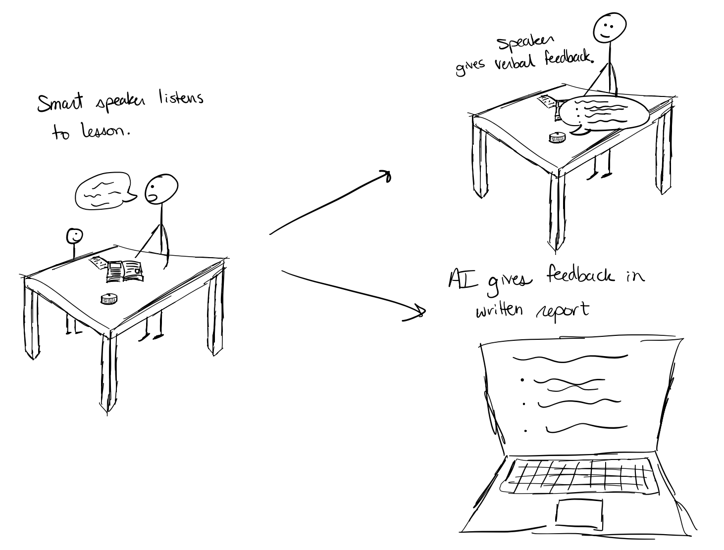
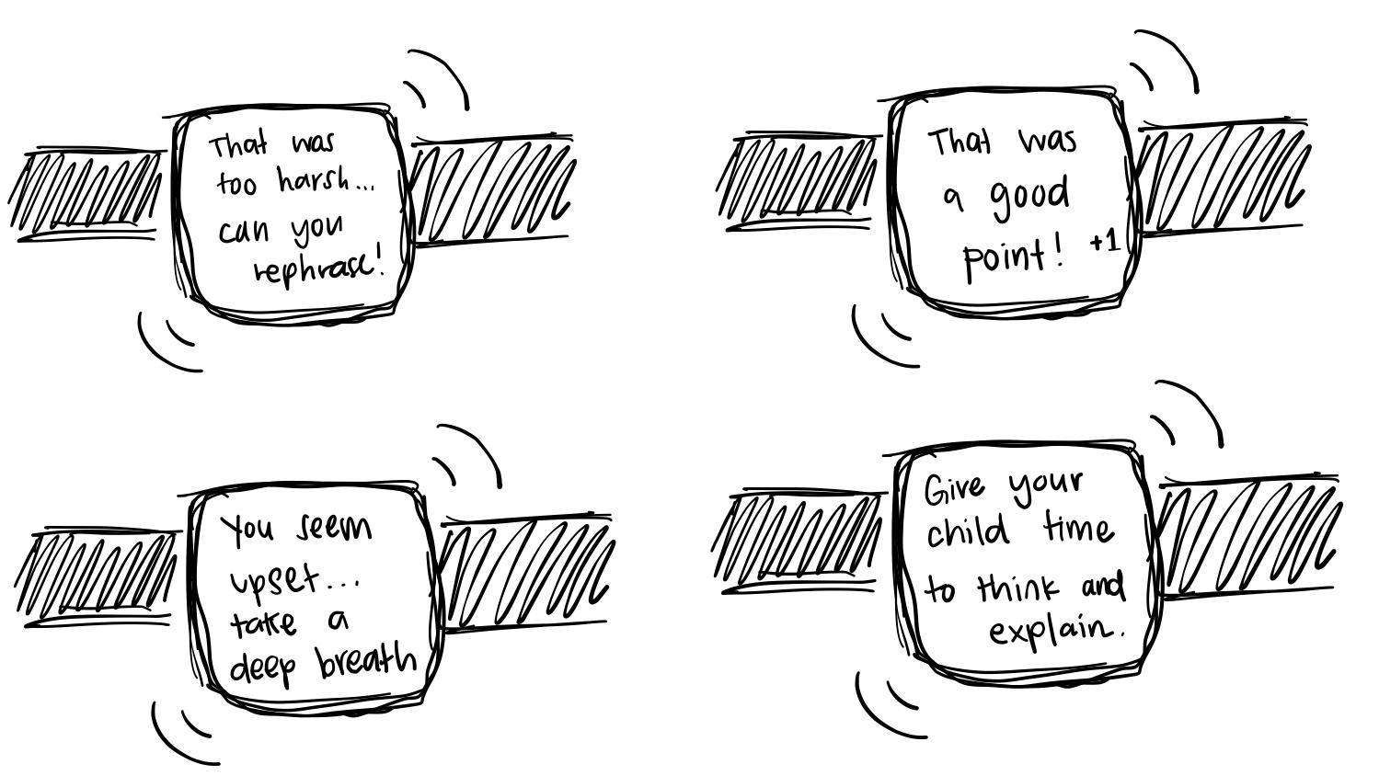
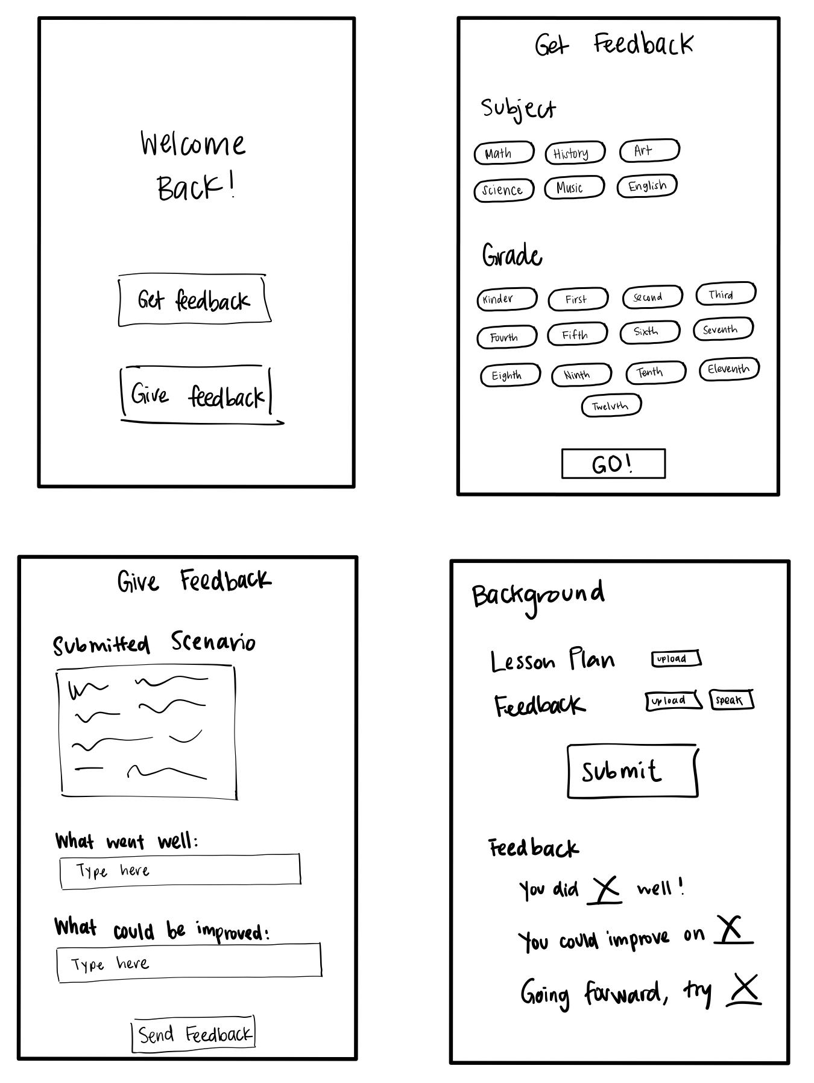
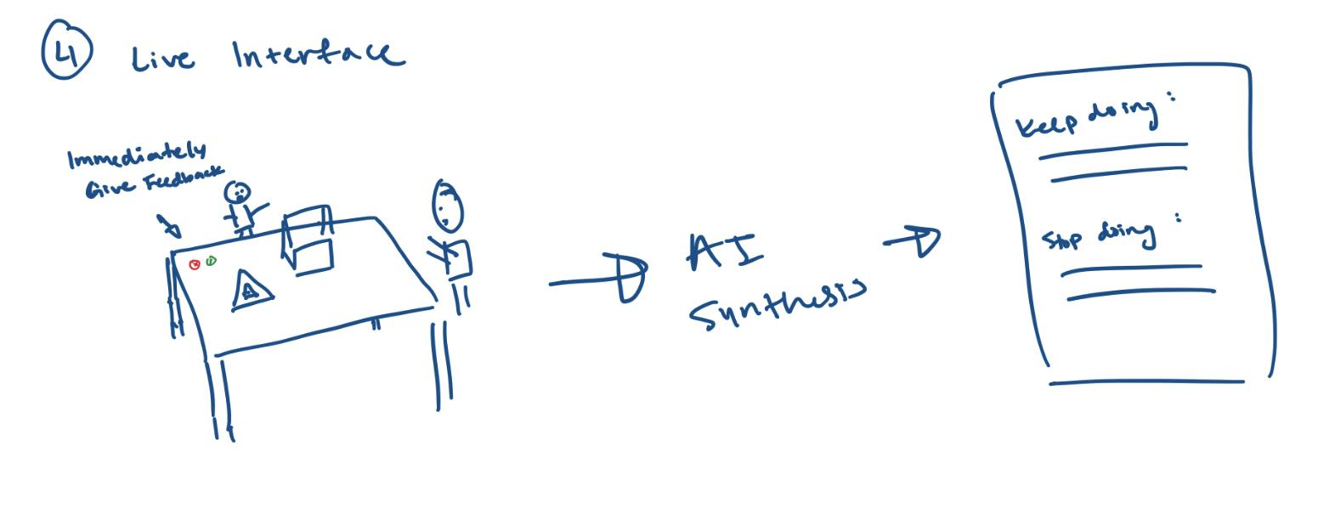
1. Virtual Reality
2. Smart speaker
3. Wearable
3
1
2
4. Table-top interface
5
4
5. Mobile app
Notes:
VR - for
Smart speaker - speech input modality
Wearables, live feedback
Live interface
Crowdsourced

Slide 10
Storyboards

Slide 11
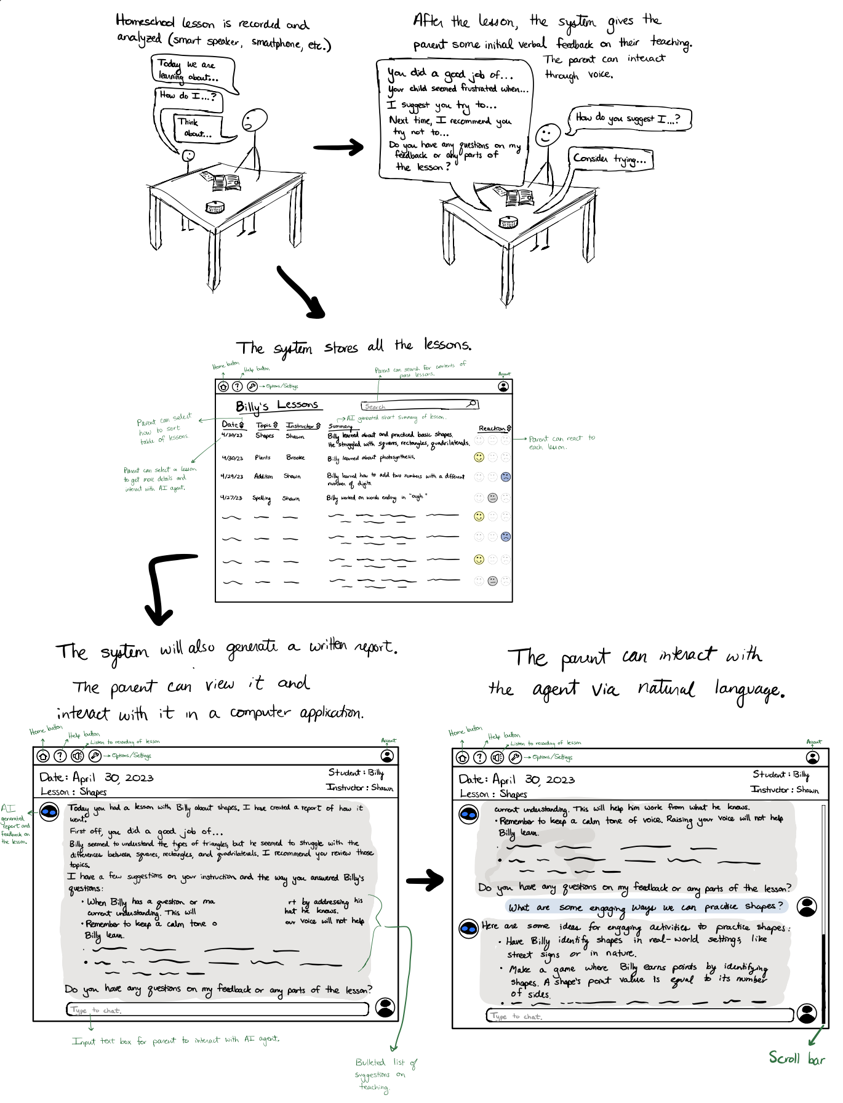
Storyboard 1:
AI lesson recorder + post-lesson feedback generation

Slide 12
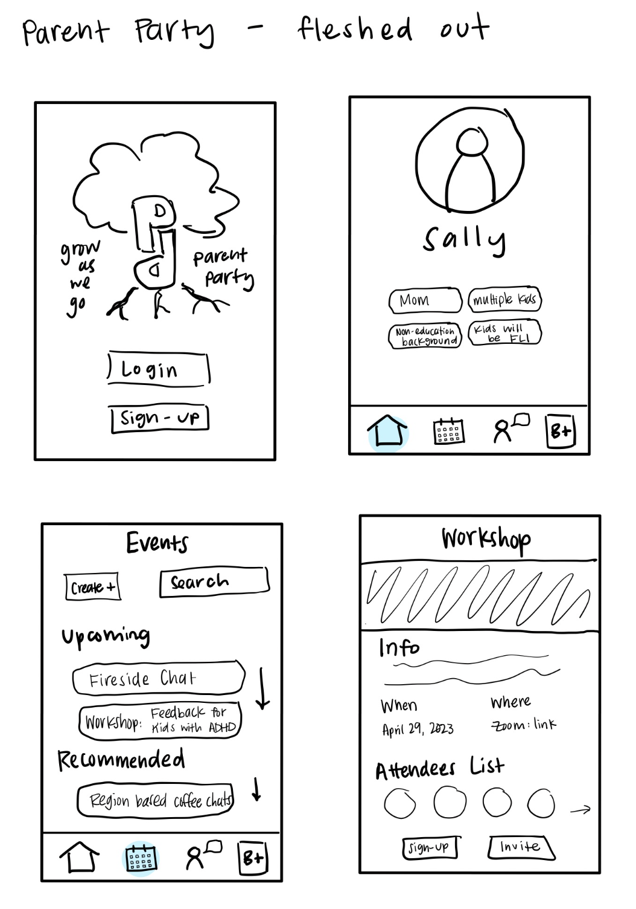
Storyboard 2:
ParentParty: Feedback Workshops for Parents
JOE

Slide 13
Pros
Pros
Cons
Cons
Parent Party
Live Feedback
Creates community, options for communities with people of similar identities
Encompasses intersectionality of identity, connections
Provides resources to support under-resourced parents trying to support their kids
Collaboration and knowledge-sharing
Feels more personal
Live data collection
Easier for parent, no burden of time
Takes child’s learning into account in real lesson
Data collection - makes it easier to track progress over time
Opt in for data collection for fine tuning model
Requires more effort/intentionality from parents
Less inclusion of the child in the process
Dependent on a social network for growth and retention
Privacy issues with recording
May feel impersonal
Not immediate feedback for each lesson - just have the AI listening in
The set-up might be difficult for people unfamiliar with the technology
Notes:
Pro of feedback: the idea of live recording such that parents wouldn’t have an extra burden of spending time
Con of parent party: dependent on other users for content, risky

Slide 14
Pros
Pros
Cons
Cons
Parent Party
Live Feedback
Creates community, options for communities with people of similar identities
Encompasses intersectionality of identity, connections
Provides resources to support under-resourced parents trying to support their kids
Collaboration and knowledge-sharing
Feels more personal
Live data collection
Easier for parent, no burden of time
Takes child’s learning into account in real lesson
Data collection - makes it easier to track progress over time
Opt in for data collection for fine tuning model
Requires more effort/intentionality from parents
Less inclusion of the child in the process
Dependent on a social network for growth and retention
Privacy issues with recording
May feel impersonal
Not immediate feedback for each lesson - just have the AI listening in
The set-up might be difficult for people unfamiliar with the technology
Notes:
Pro of feedback: the idea of live recording such that parents wouldn’t have an extra burden of spending time
Con of parent party: dependent on other users for content, risky

Slide 15

Prototype
Scan me!

Slide 16
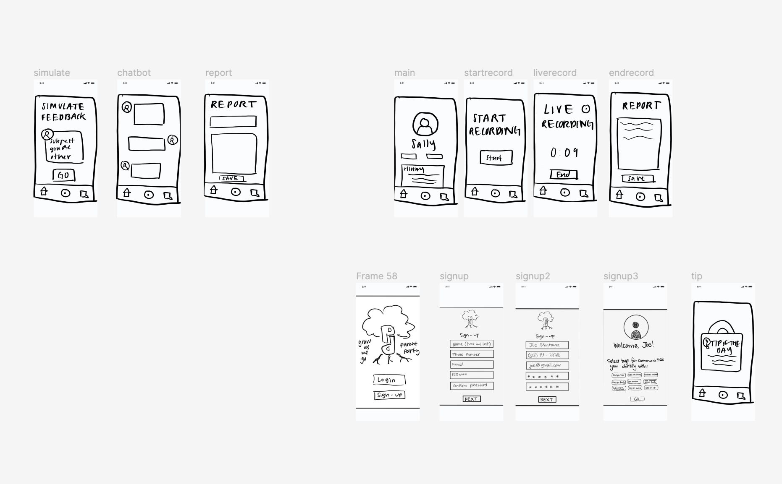


Slide 17
Experiment

Slide 18


Participants
Homeschooling mother of 3
(Zoom)
Homeschooling father of 2
(Zoom)
Mother of 4, homeschooling youngest 2
(Zoom)
Homeschooling father of 4
(In-person)
Notes:
Interviewed 4 parents, some of whom are still homeschooling and some of who homeschooled in the past
3 Zoom, 1 in-person
Figma prototype

Slide 19
Tasks

Slide 20



Tasks
Task 1
Task 2
Task 3
Sign-up and find the “Tip of the Day”
Record a live lesson and view generated feedback
Participate in teaching and feedback simulation

Slide 21
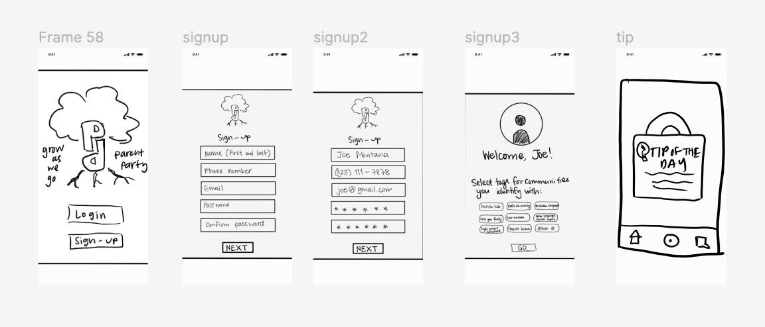
1: Tip of the Day (simple)

Slide 22
Task 1
Procedure:
Sign-up for the app
Find the tip of the day generated for you.
Sign-up and find the “Tip of the Day”

Slide 23
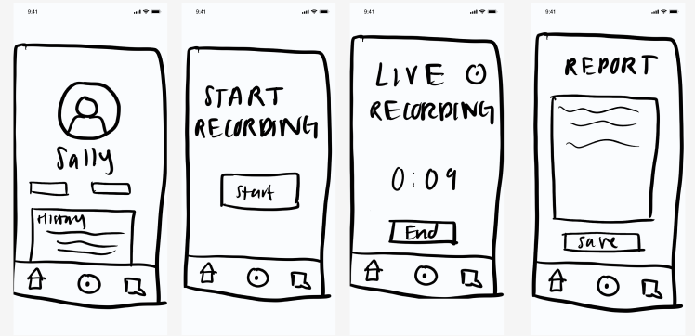
2: Live Recording (moderate)
JOE

Slide 24
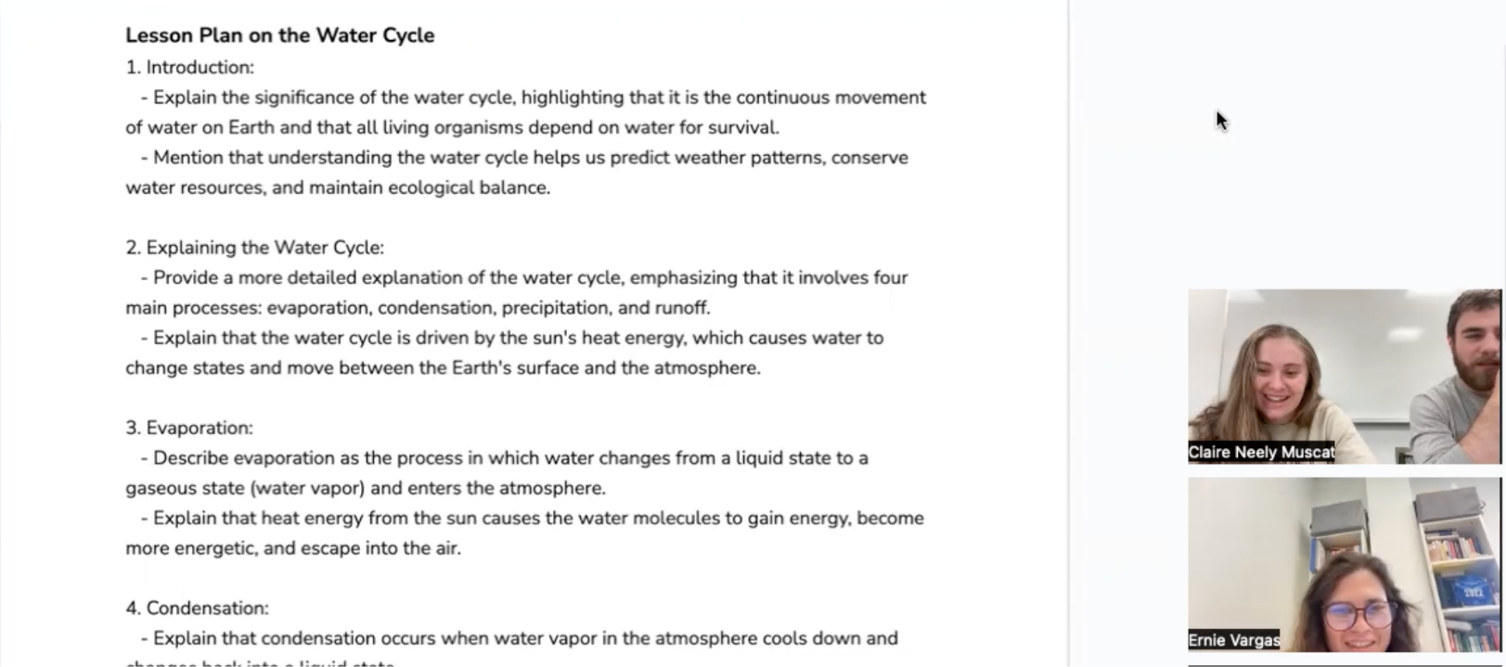
Task 2
Procedure:
“Record” a live lesson and interact with the feedback given by the app
Teach on a short pre-created curriculum
Answer student questions
Interact with the feedback that is given to you after teaching the lesson
Record a live lesson and view generated feedback

Slide 25
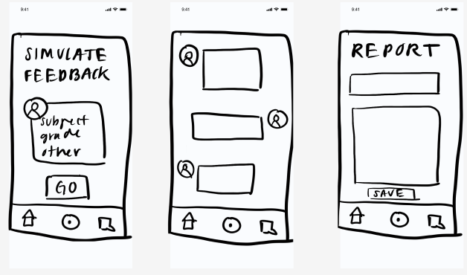
3: Feedback Simulator (complex)
JOE

Slide 26
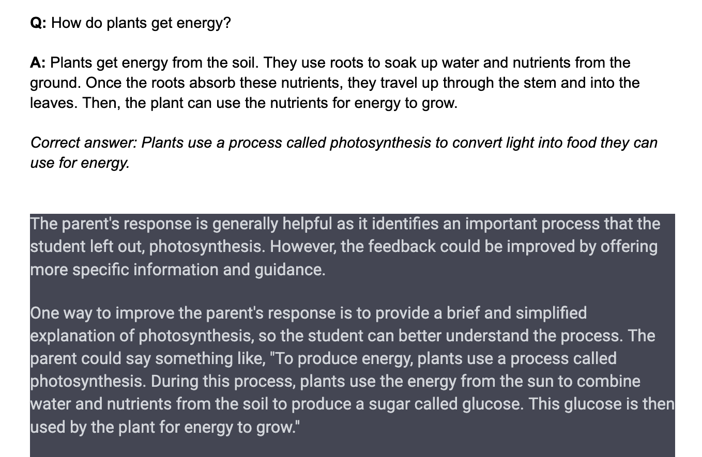
Task 3
Procedure:
Engage in simulation with AI
Analyze practice student responses to questions
Give student feedback on their answers
Interact with feedback given on the feedback for the student.
Participate in teaching and feedback simulation

Slide 27

Results + Key Insights
Time is a key resource: no time for the simulation
Privacy concerns: ability to edit input before sending
AI is non-threatening: no pressure of judgment
Student feedback matters: include them in the process
Proxy for expensive Teacher Ed programs
“(as a homeschooling parent) Your life is very integrated. It’s go go go. You don’t often take time to sit, pause, and look back at what you did. This encourages and forces looking back.” – P1
Notes:
Tie in quote to first insight listed

Slide 28
Next Steps
Go deeper with the live-lesson feedback agent
Consider eliminating feedback simulation
Include child feedback about lesson
Ensure UI is self explanatory

Slide 29
Thank you!
Questions? Feedback?

Slide 30
Appendix

Slide 31
Concept Sketches

Slide 32
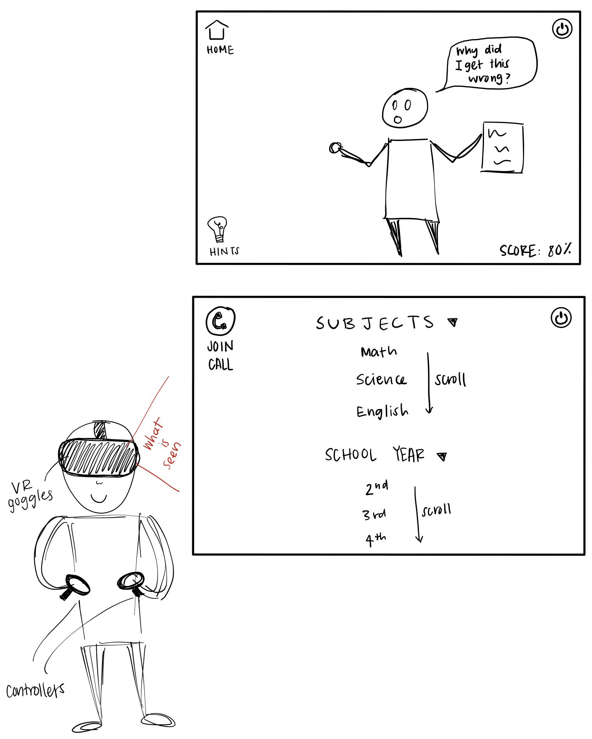
Concept Sketches - Virtual Reality
1 and 2: Virtual Reality (VR) for teaching and feedback simulation

Slide 33
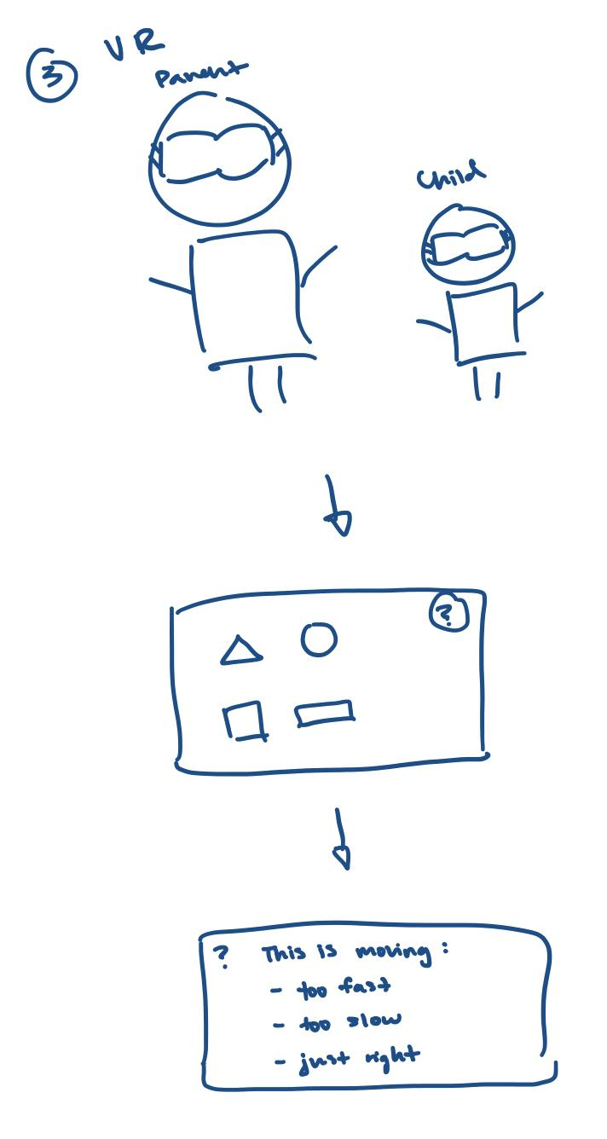
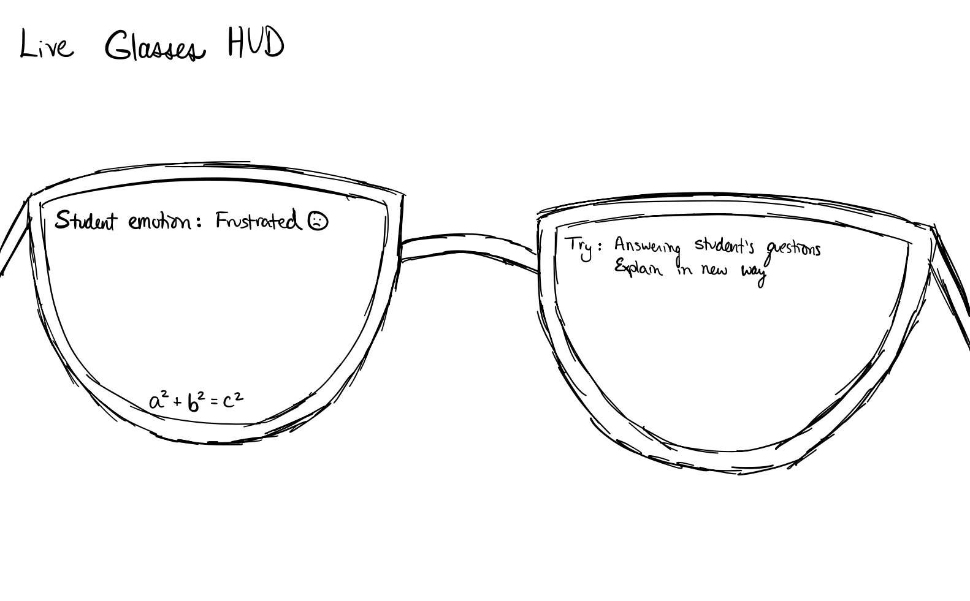
Concept Sketches - Virtual Reality / Augmented Reality
3: Virtual Reality (VR)
4: Augmented Reality (AR) glasses for live feedback

Slide 34
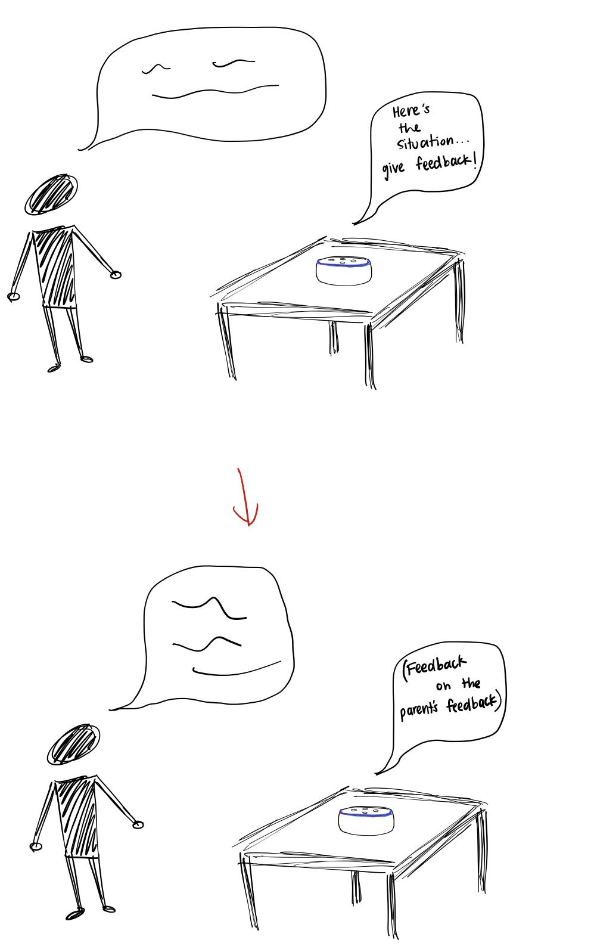
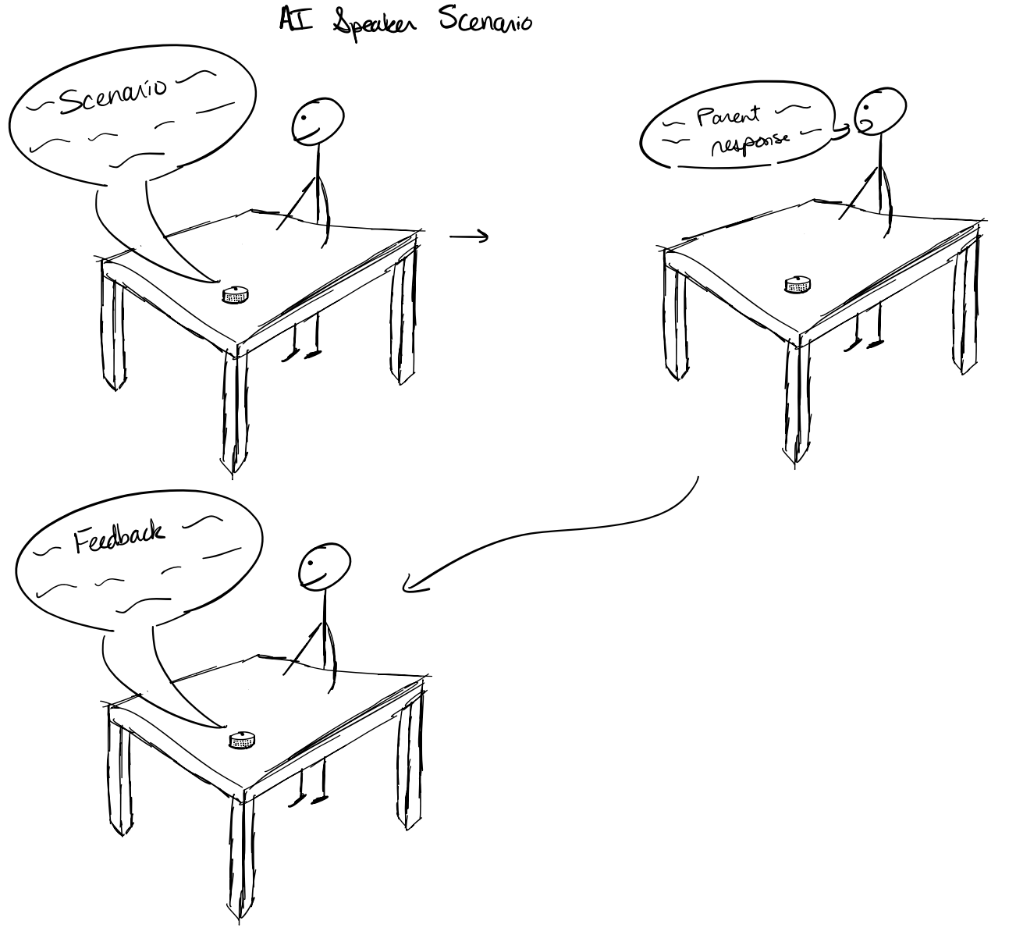
Concept Sketches
5, 6, and 7: Live-lesson recording and AI-generated reports

Slide 35
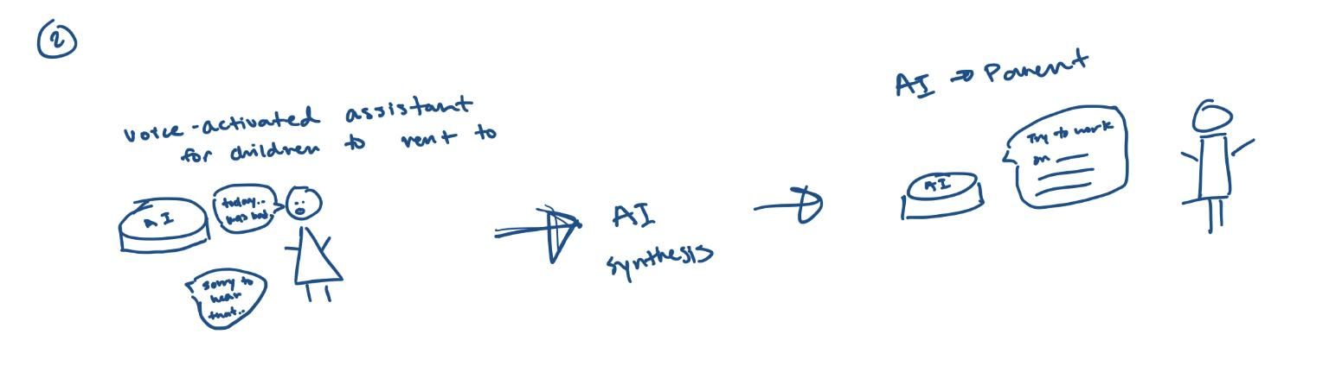
Concept Sketches
8: Voice Assistant for live feedback during lessons

Slide 36
Concept Sketches
9: Table-top interface for live feedback
10: Wearables for live notifications

Slide 37
Concept Sketches
11: Mobile app for crowdsourced feedback and community

Slide 38
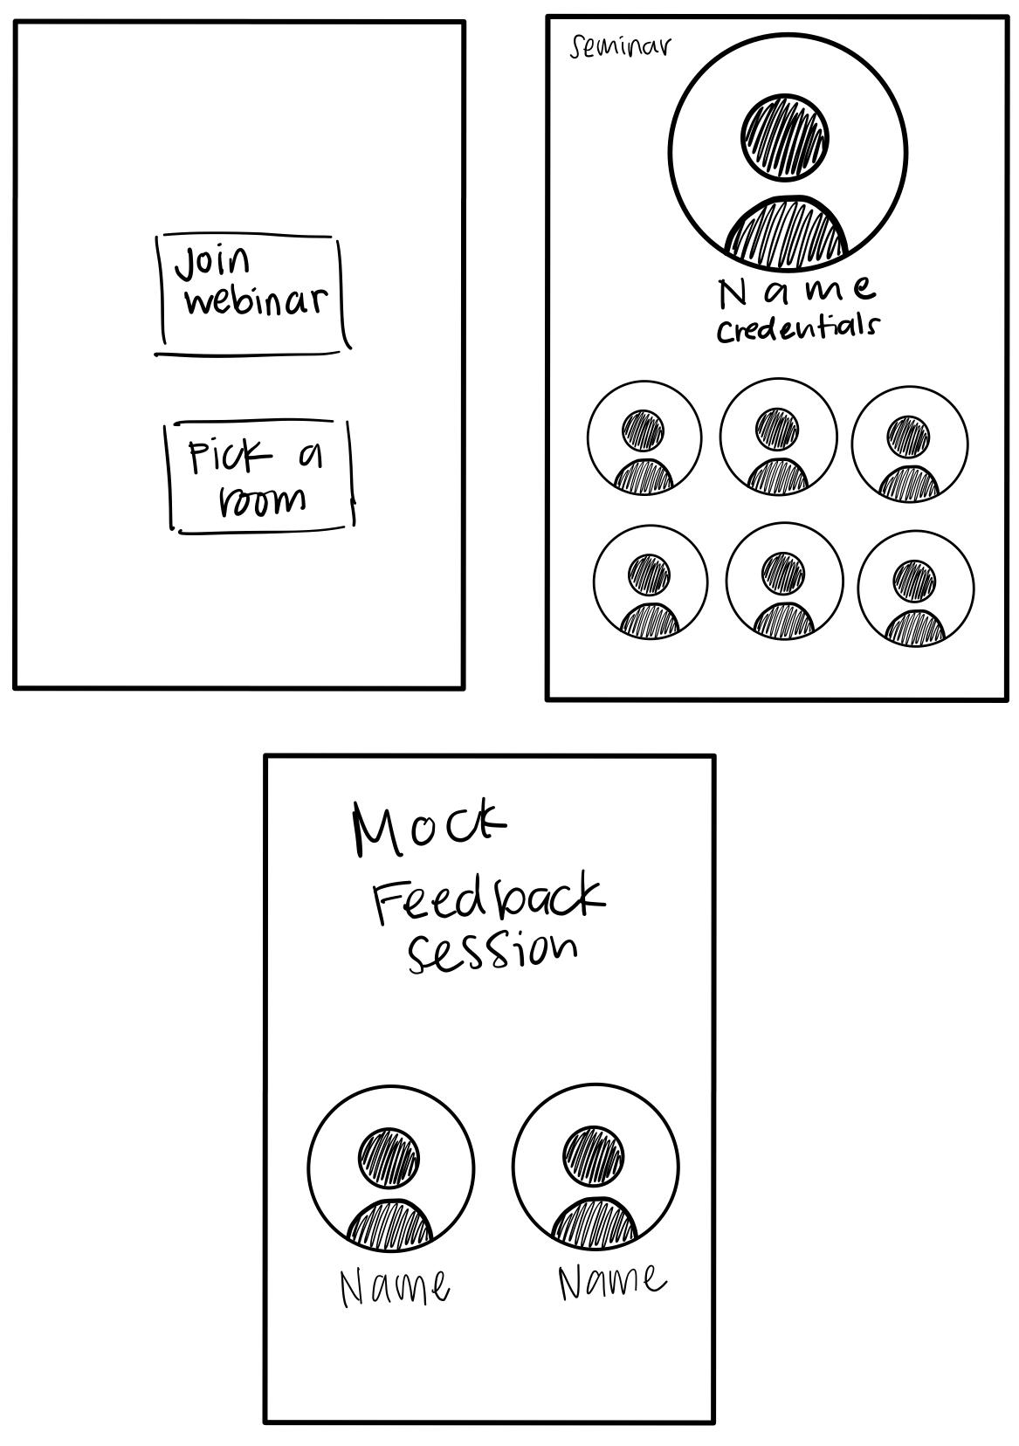
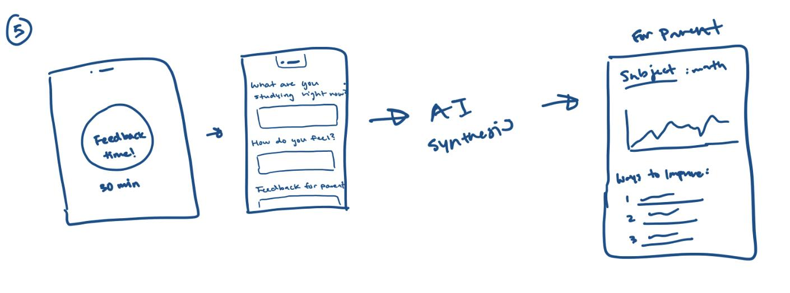
Concept Sketches
12: Mobile app for practicing feedback
13: Mobile app for live, mock feedback sessions

Slide 39
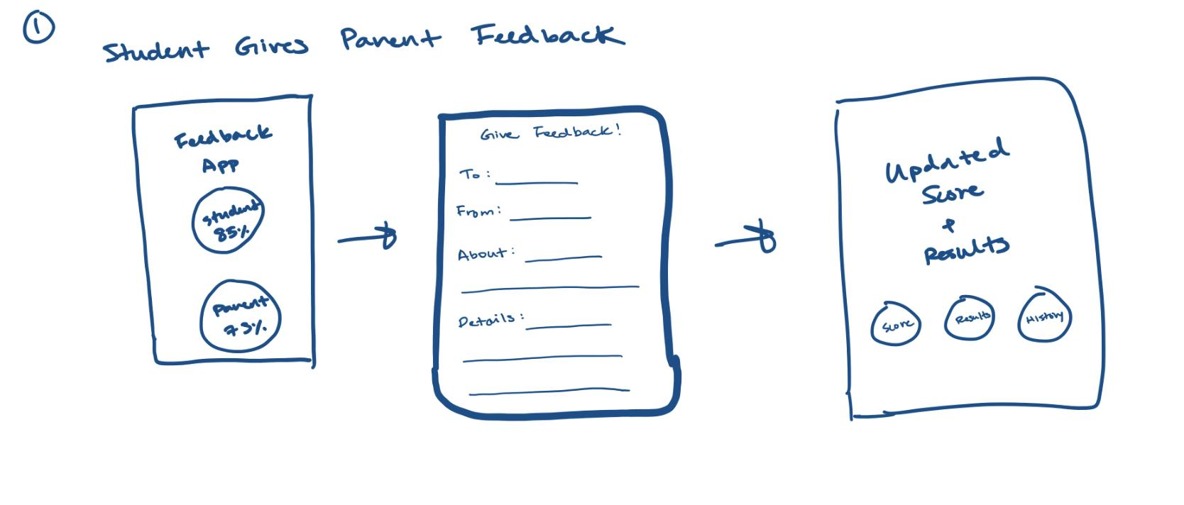
Concept Sketches
14: Mobile app for performance analysis of teaching and giving feedback

Slide 40
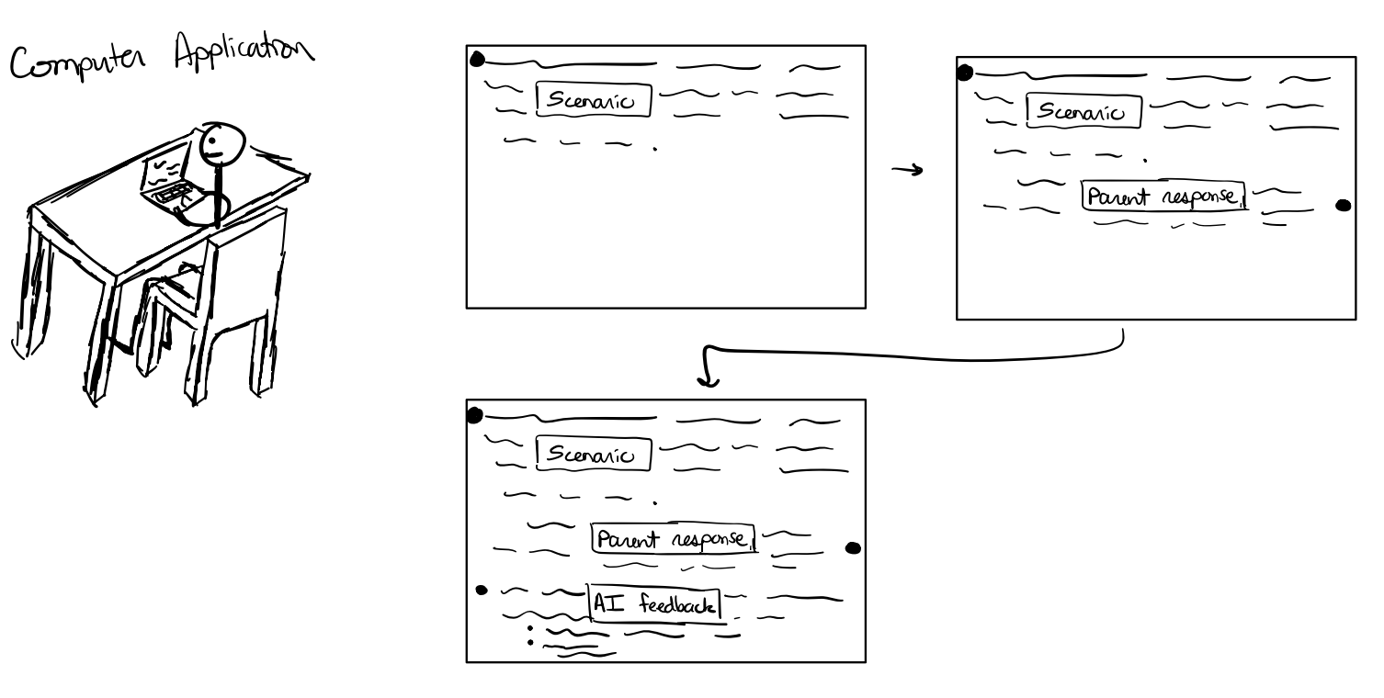
Concept Sketches
15: Web app for teaching and feedback simulation

Slide 41
Prototype
https://www.figma.com/file/oCOuGJZPxVFXkWoMFWCuvR/CS377E?type=design&node-id=0-1&t=TDS2qfFB1HWxae0W-0

Slide 42
Results
Simulation took too long
Concerns about privacy with recording
Parents appreciated having a consolidated resource – would like as much streamlining as possible
Liked live use case - can take it on the go
Audio recording does not capture visual aid use
Having examples of “good” teaching and feedback would be nice

Slide 43
Key Insights
Time is a key resource: no time for the simulation
Privacy concerns: ability to edit input before sending
AI is non-threatening: no pressure of judgment
Student feedback matters: include them in the process
Reports help parents to take the time to reflect
Proxy for expensive Teacher Ed programs
Building confidence leads to self-efficacy
“(as a homeschooling parent) Your life is very integrated. It’s go go go. You don’t often take time to sit, pause, and look back at what you did. This encourages and forces looking back.” – P1

